Slide 1
Chapter 8:
Data Abstractions
Computer Science: An Overview
Eleventh Edition
by
J. Glenn Brookshear

Slide 2
Chapter 8: Data Abstractions
8.1 Data Structure Fundamentals
8.2 Implementing Data Structures
8.3 A Short Case Study
8.4 Customized Data Types
8.5 Classes and Objects
8.6 Pointers in Machine Language
0-<number>

Slide 3
Basic Data Structures
Homogeneous array
Heterogeneous array
List
  Stack
  Queue
Tree
0-<number>

Slide 4
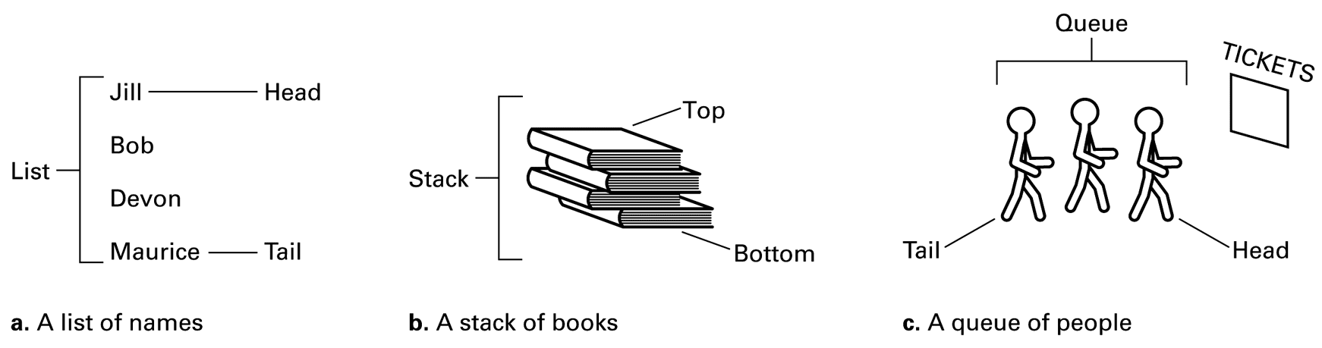
Figure 8.1 Lists, stacks, and queues
0-<number>

Slide 5
Terminology for Lists
List: A collection of data whose entries are arranged sequentially
Head: The beginning of the list
Tail: The end of the list
0-<number>

Slide 6
Terminology for Stacks
Stack: A list in which entries are removed and inserted only at the head
LIFO: Last-in-first-out
Top: The head of list (stack)
Bottom or base: The tail of list (stack)
Pop: To remove the entry at the top
Push: To insert an entry at the top
0-<number>

Slide 7
Terminology for Queues
Queue: A list in which entries are removed at the head and are inserted at the tail
FIFO: First-in-first-out
0-<number>

Slide 8
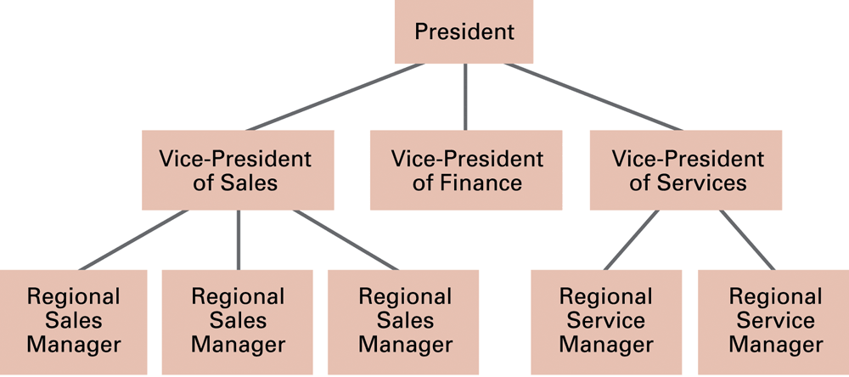
Figure 8.2 An example of an organization chart
0-<number>

Slide 9
Terminology for a Tree
Tree: A collection of data whose entries have a hierarchical organization
Node: An entry in a tree
Root node: The node at the top
Terminal or leaf node: A node at the bottom
0-<number>

Slide 10
Terminology for a Tree (continued)
Parent: The node immediately above a specified node
Child: A node immediately below a specified node
Ancestor: Parent, parent of parent, etc.
Descendent: Child, child of child, etc.
Siblings: Nodes sharing a common parent
0-<number>

Slide 11
Terminology for a Tree (continued)
Binary tree: A tree in which every node has at most two children
Depth: The number of nodes in longest path from root to leaf
0-<number>

Slide 12
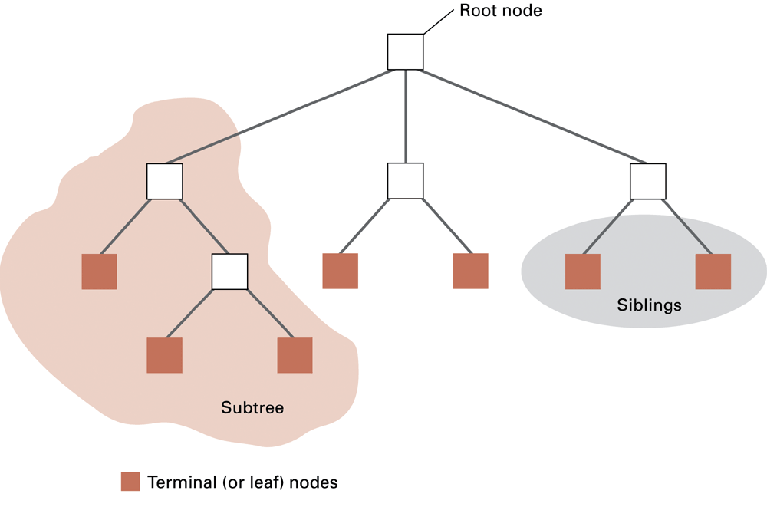
Figure 8.3 Tree terminology
0-<number>

Slide 13
Additional Concepts
Static Data Structures: Size and shape of data structure does not change
Dynamic Data Structures: Size and shape of data structure can change
Pointers: Used to locate data
0-<number>

Slide 14
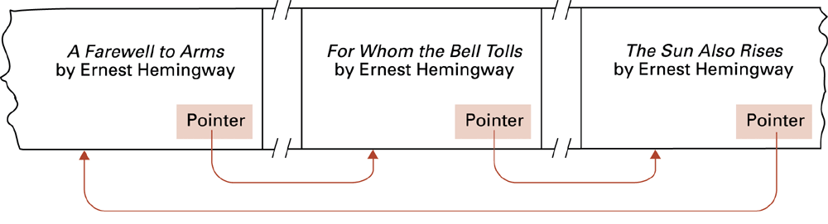
Figure 8.4 Novels arranged by title but linked according to authorship
0-<number>

Slide 15
Storing Arrays
Homogeneous arrays
  Row-major order versus column major order
  Address polynomial
Heterogeneous arrays
  Components can be stored one after the other in a contiguous block
  Components can be stored in separate locations identified by pointers
0-<number>

Slide 16
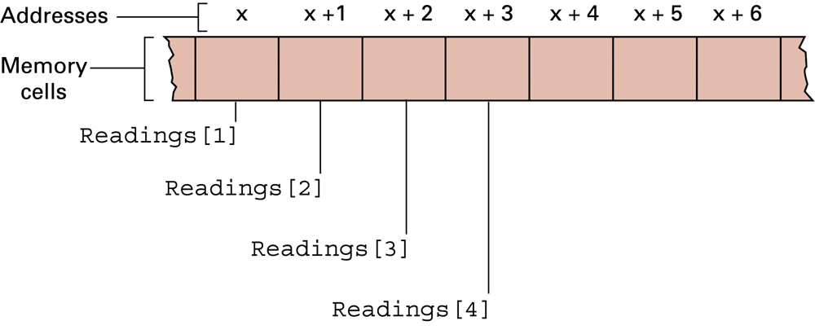
Figure 8.5 The array of temperature readings stored in memory starting at address x
0-<number>

Slide 17
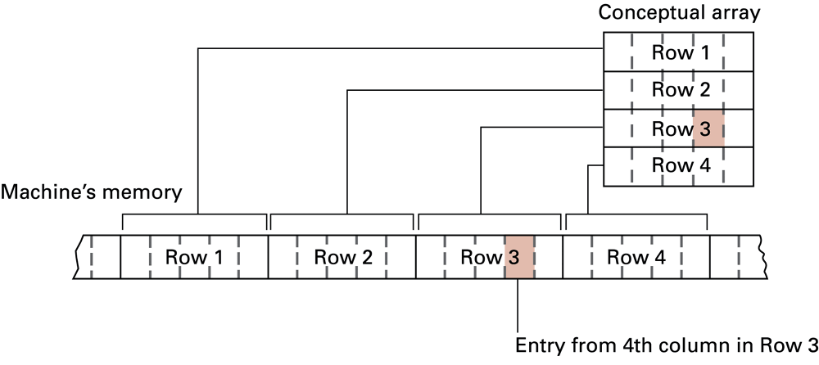
Figure 8.6 A two-dimensional array with four rows and five columns stored in row major order
0-<number>

Slide 18
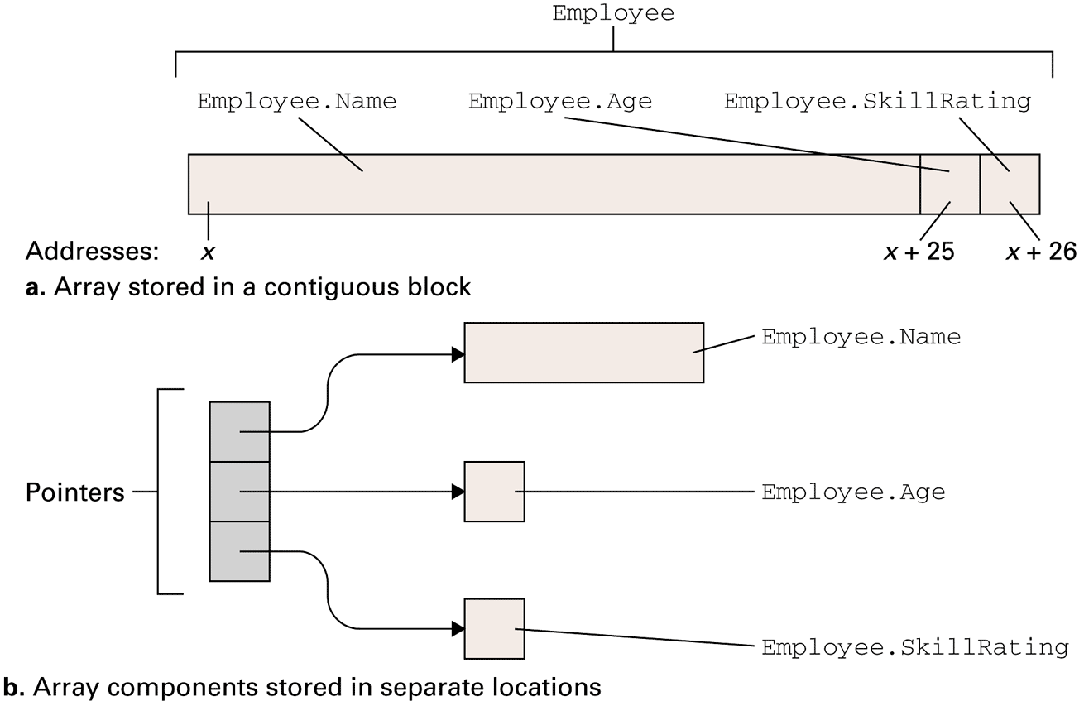
Figure 8.7 Storing the heterogeneous array Employee
0-<number>

Slide 19
Storing Lists
Contiguous list: List stored in a homogeneous array
Linked list: List in which each entries are linked by pointers
  Head pointer: Pointer to first entry in list
  NIL pointer: A “non-pointer” value used to indicate end of list
0-<number>

Slide 20
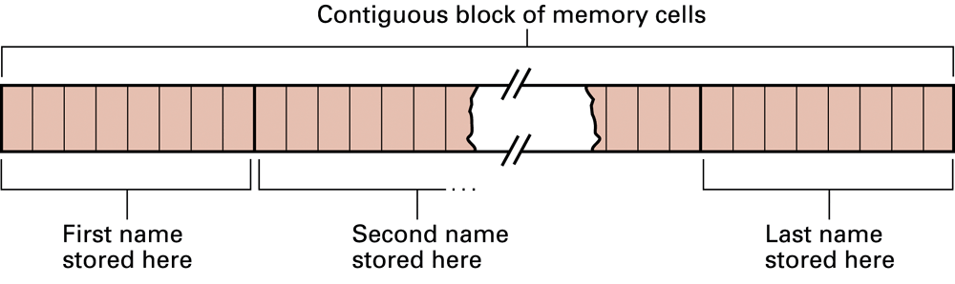
Figure 8.8 Names stored in memory as a contiguous list
0-<number>

Slide 21
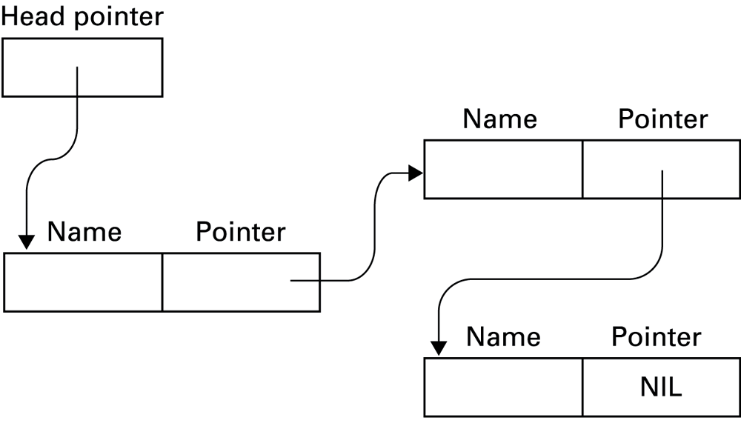
Figure 8.9 The structure of a linked list
0-<number>

Slide 22
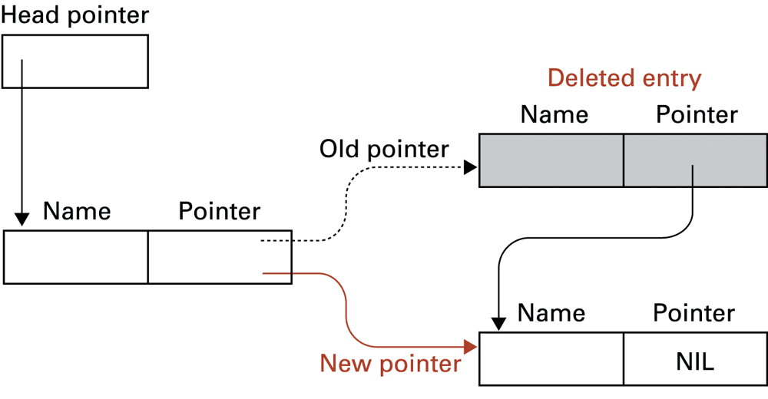
Figure 8.10 Deleting an entry from a linked list
0-<number>

Slide 23
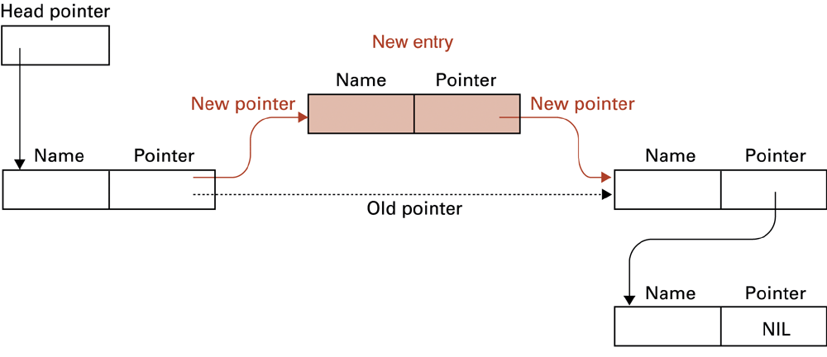
Figure 8.11 Inserting an entry into a linked list
0-<number>

Slide 24
Storing Stacks and Queues
Stacks usually stored as contiguous lists
Queues usually stored as Circular Queues
  Stored in a contiguous block in which the first entry is considered to follow the last entry
  Prevents a queue from crawling out of its allotted storage space
0-<number>

Slide 25
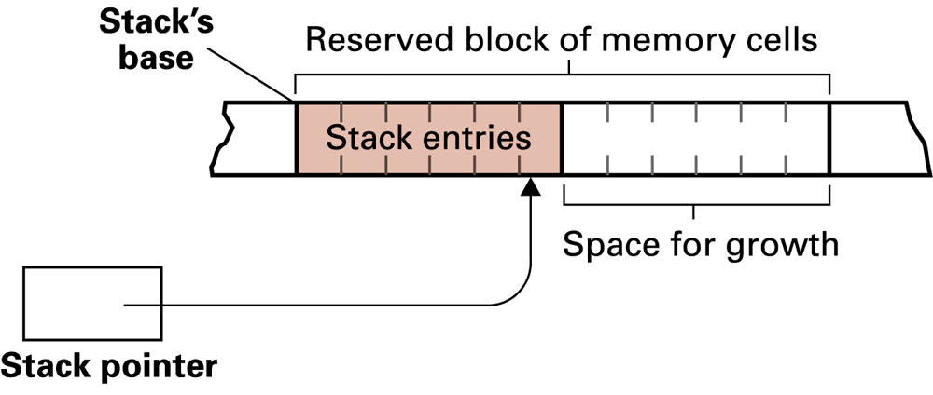
Figure 8.12 A stack in memory
0-<number>

Slide 26
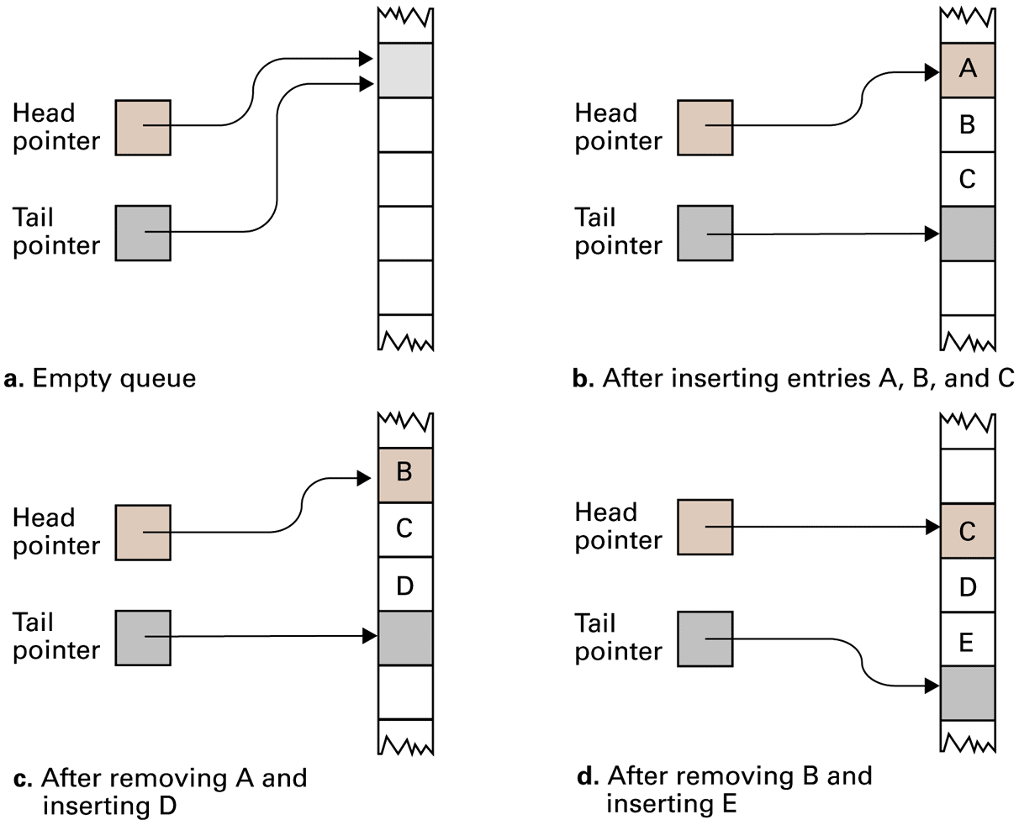
Figure 8.13 A queue implementation with head and tail pointers
0-<number>

Slide 27
Storing Binary Trees
Linked structure
  Each node = data cells + two child pointers
  Accessed via a pointer to root node
Contiguous array structure
  A[1] = root node
  A[2],A[3] = children of A[1]
  A[4],A[5],A[6],A[7] = children of A[2] and A[3]
0-<number>

Slide 28
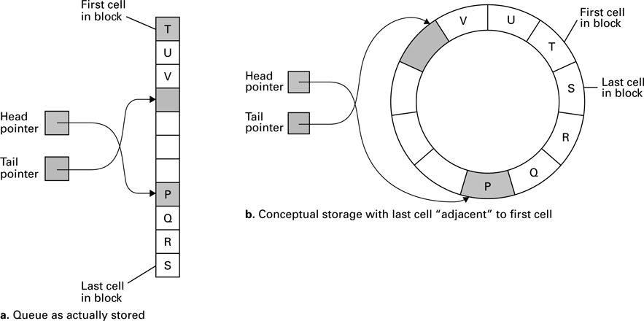
Figure 8.14 A circular queue containing the letters P through V
0-<number>

Slide 29
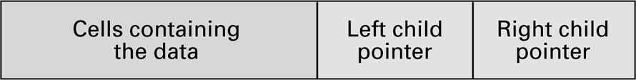
Figure 8.15 The structure of a node in a binary tree
0-<number>

Slide 30
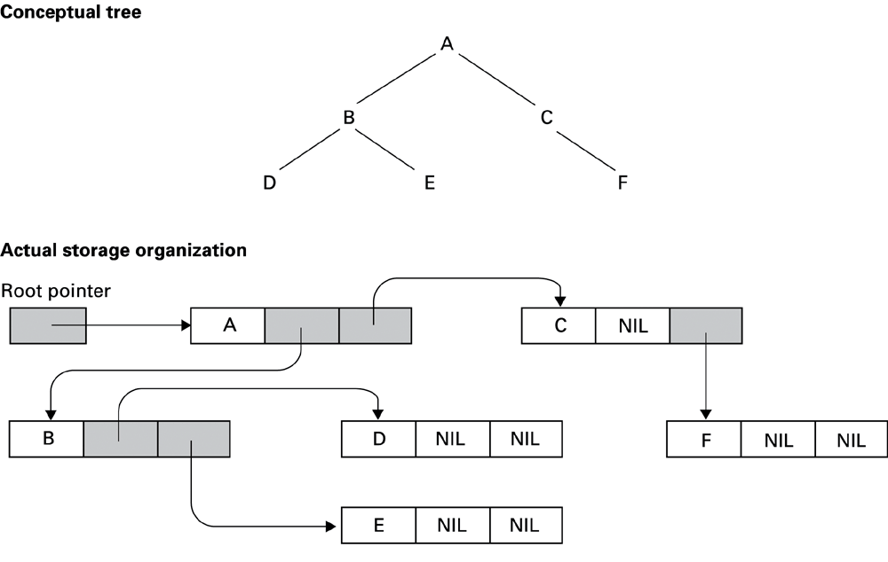
Figure 8.16 The conceptual and actual organization of a binary tree using a linked storage system
0-<number>

Slide 31
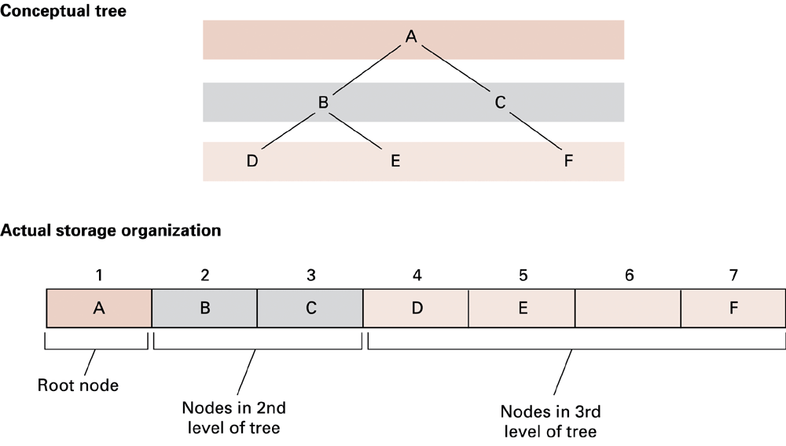
Figure 8.17 A tree stored without pointers
0-<number>

Slide 32
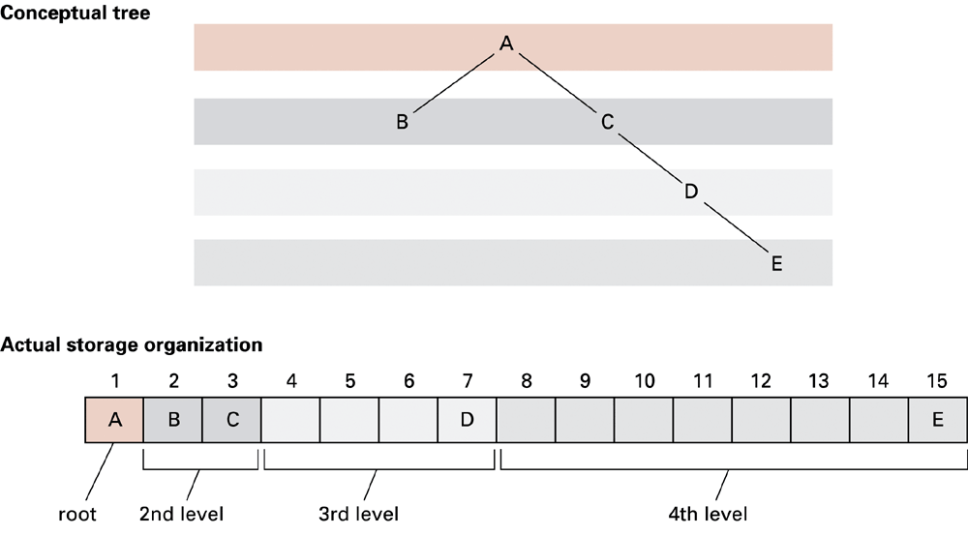
Figure 8.18 A sparse, unbalanced tree shown in its conceptual form and as it would be stored without pointers
0-<number>

Slide 33
Manipulating Data Structures
Ideally, a data structure should be manipulated solely by pre-defined procedures.
  Example: A stack typically needs at least push and pop procedures.
  The data structure along with these procedures constitutes a complete abstract tool.
0-<number>

Slide 34
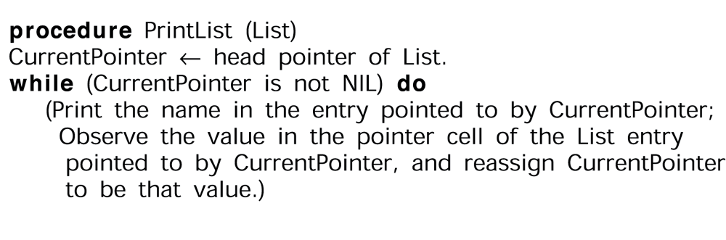
Figure 8.19 A procedure for printing a linked list
0-<number>

Slide 35
Case Study
Problem: Construct an abstract tool consisting of a list of names in alphabetical order along with the operations search, print, and insert.
0-<number>

Slide 36
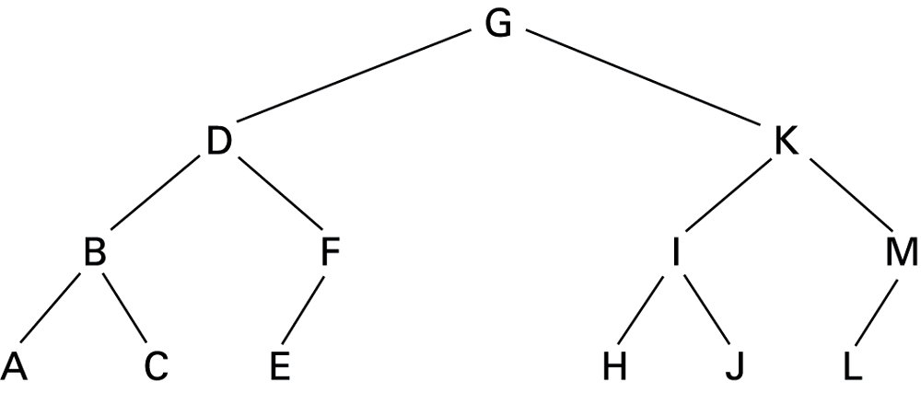
Figure 8.20 The letters A through M arranged in an ordered tree
0-<number>

Slide 37
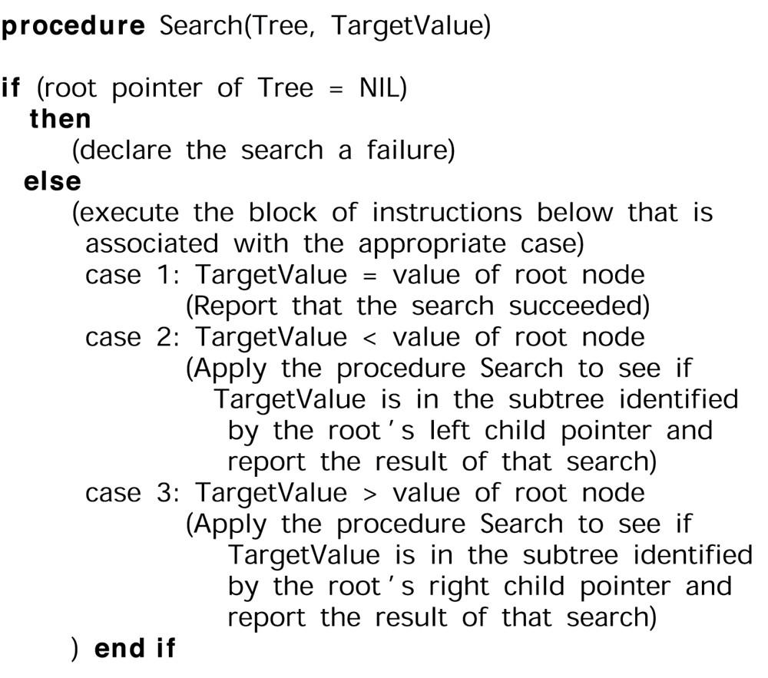
Figure 8.21 The binary search as it would appear if the list were implemented as a linked binary tree
0-<number>

Slide 38
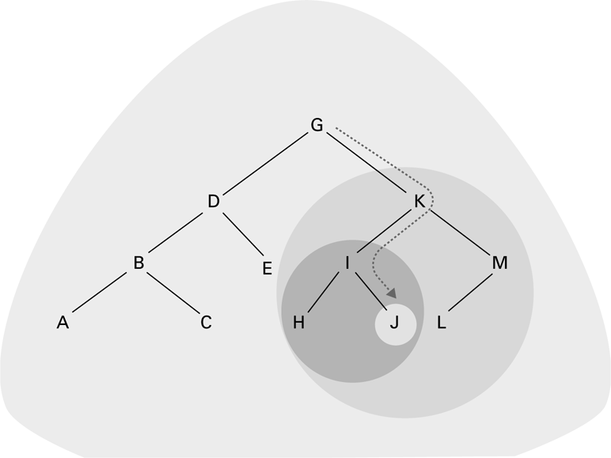
Figure 8.22 The successively smaller trees considered by the procedure in Figure 8.18 when searching for the letter J
0-<number>

Slide 39
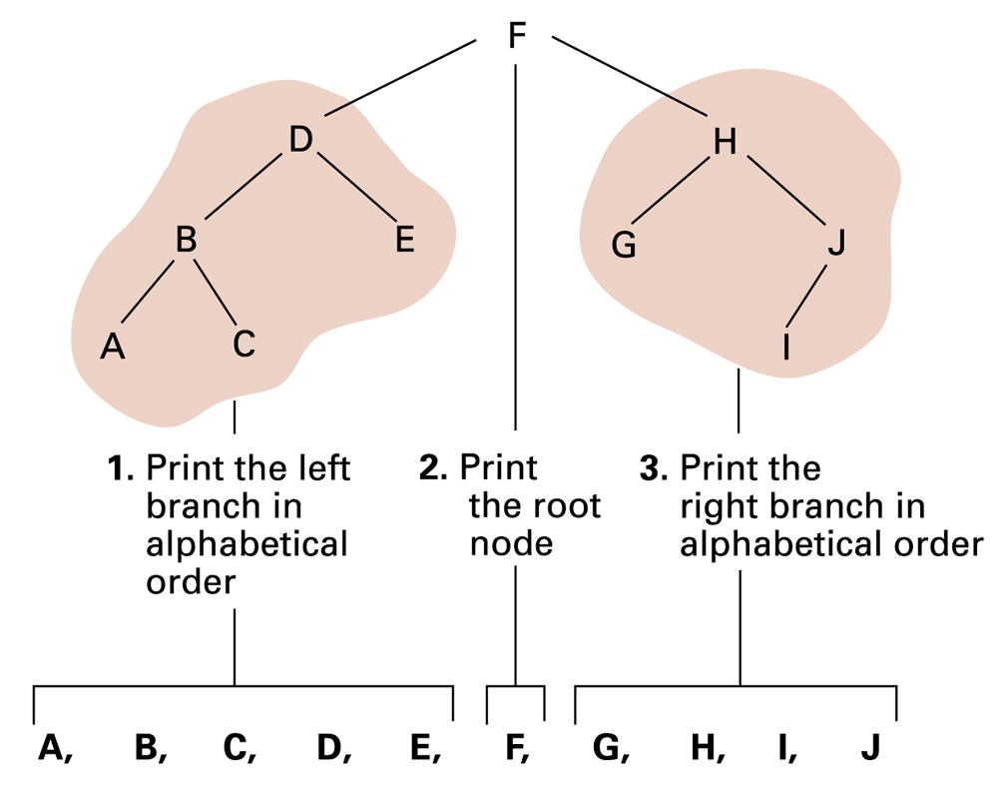
Figure 8.23 Printing a search tree in alphabetical order
0-<number>

Slide 40
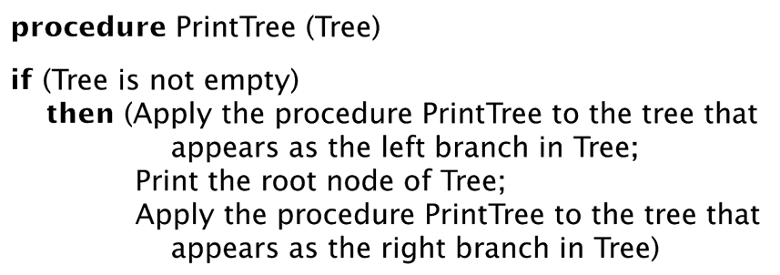
Figure 8.24 A procedure for printing the data in a binary tree
0-<number>

Slide 41
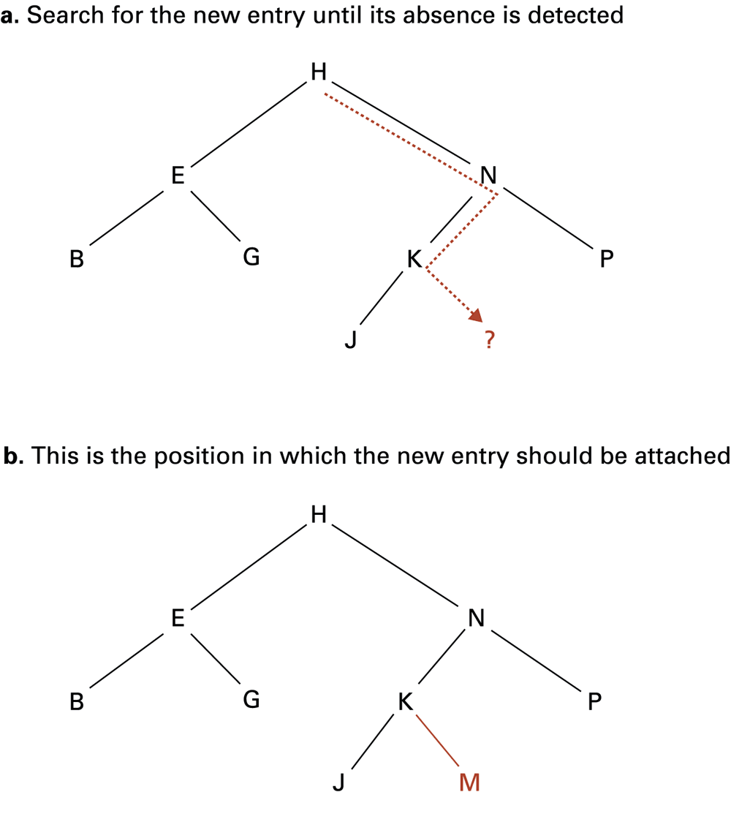
Figure 8.25 Inserting the entry
M into the list B, E, G, H, J, K, N, P stored as a tree
0-<number>

Slide 42
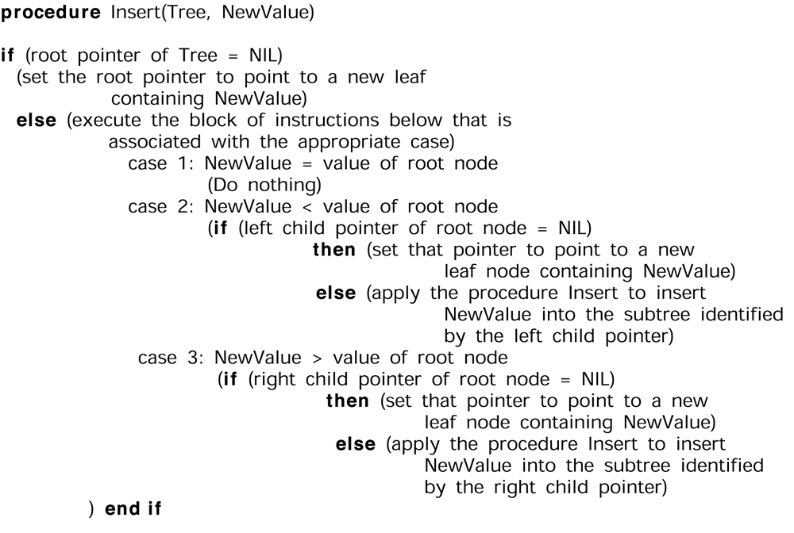
Figure 8.26 A procedure for inserting a new entry in a list stored as a binary tree
0-<number>

Slide 43
User-defined Data Type
A template for a heterogeneous structure
Example:
define type EmployeeType to be
{char Name[25];
int Age;
real SkillRating;
}
0-<number>

Slide 44
Abstract Data Type
A user-defined data type with procedures for access and manipulation
Example:
define type StackType to be
{int StackEntries[20];
int StackPointer = 0;
procedure push(value)
{StackEntries[StackPointer] ← value;
StackPointer ¬ StackPointer + 1;
}
procedure pop . . .
}
0-<number>

Slide 45
Class
An abstract data type with extra features
  Characteristics can be inherited
  Contents can be encapsulated
  Constructor methods to initialize new objects
0-<number>

Slide 46
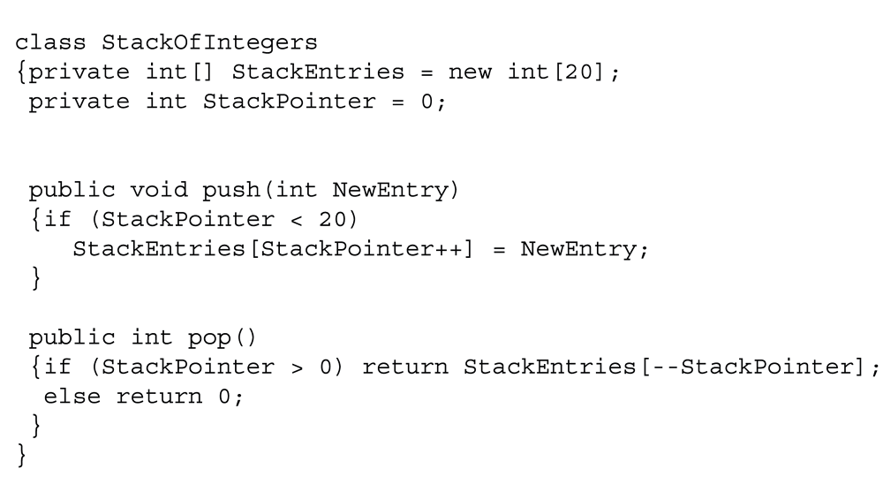
Figure 8.27 A stack of integers implemented in Java and C#
0-<number>

Slide 47
Pointers in Machine Language
Immediate addressing: Instruction contains the data to be accessed
Direct addressing: Instruction contains the address of the data to be accessed
Indirect addressing: Instruction contains the location of the address of the data to be accessed
0-<number>

Slide 48
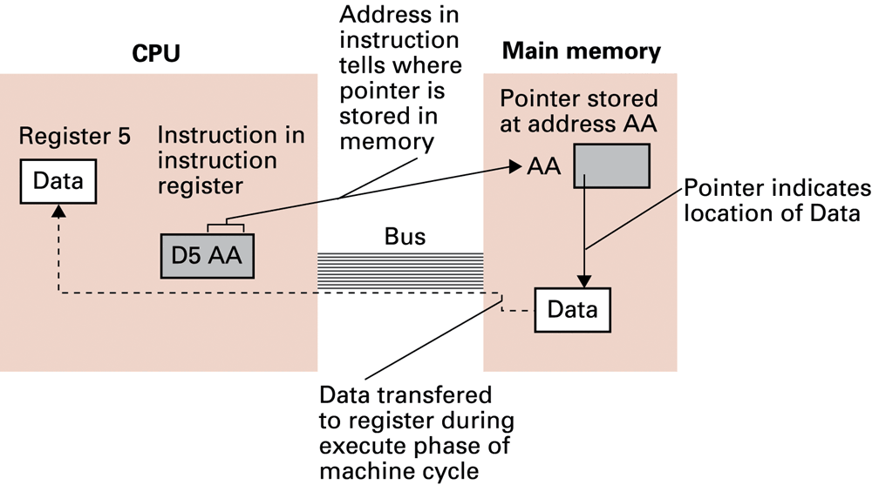
Figure 8.28 Our first attempt at expanding the machine language in Appendix C to take advantage of pointers
0-<number>

Slide 49
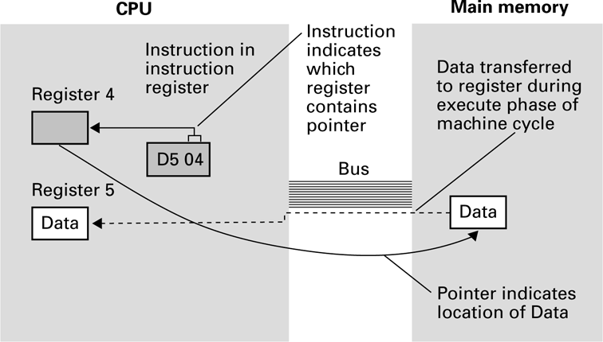
Figure 8.29 Loading a register from a memory cell that is located by means of a pointer stored in a register
0-<number>

